Slide 1
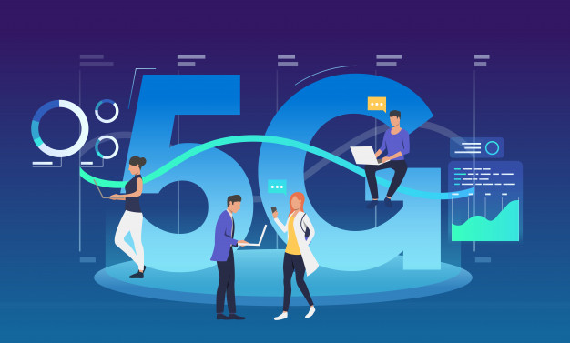
How 5G could change your life?
Muhammad Awais
P20-0107
Section A

Slide 2
Click Here My Presentation Video

Slide 3

Table of Content
What is 5G?
Evolution from 1G to 5G
Features
Uses of 5G
Advantages
Conclusion

Slide 4
What is 5G ?
5G Wireless: 5th generation wireless technology
Complete wireless communication with almost no limitations
Can be called REAL wireless world
Has incredible transmission speed
Concept is only theory not real

Slide 5
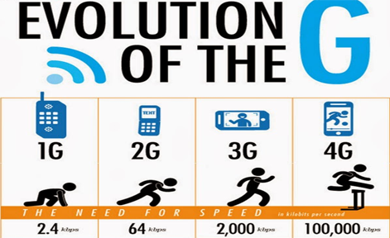
Evolution from 1G to 5G
1G
2G
3G
4G
5G

Slide 6
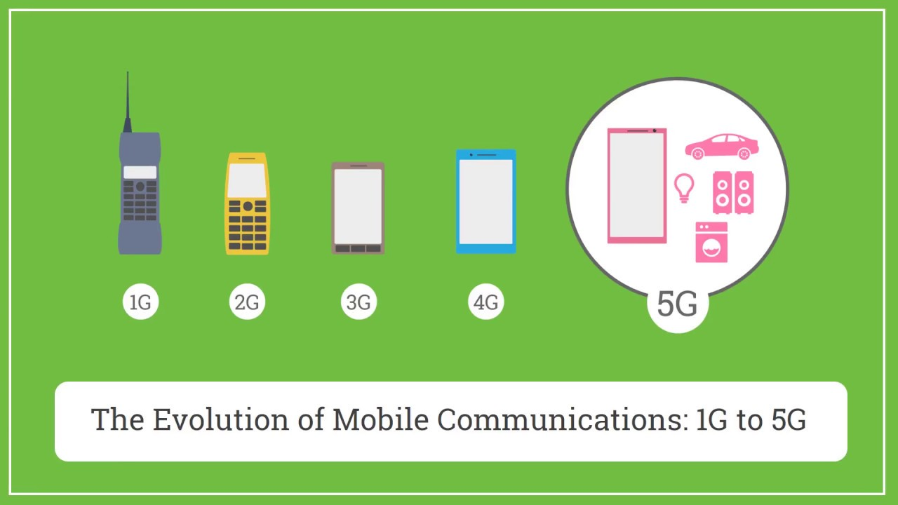

Slide 7

Features of 5G
High resolution for crazy cell phone users
Bi-directional large BW
Less traffic
25 Mbps connectivity speed
Enhanced & available connectivity just about the world
Uploading & Downloading speed of 5G touching the peak (up to 1 Gbps)
Better & fast solution

Slide 8
Use of 5G
Hologram
Smart City
Smart Grids
Satellite
360 Video – 3D – HD – Virtual Reality
FWA – Fixed Wireless Access
Remote Surgery
Industrial Robots, Co-Bots (Collaborative Robots)
Humanoid, Service, Therapeutic Robots
Autonomous Vehicle
Very High Speed Train
Drones and Unmanned Aerial Vehicle (UAV)

Slide 9
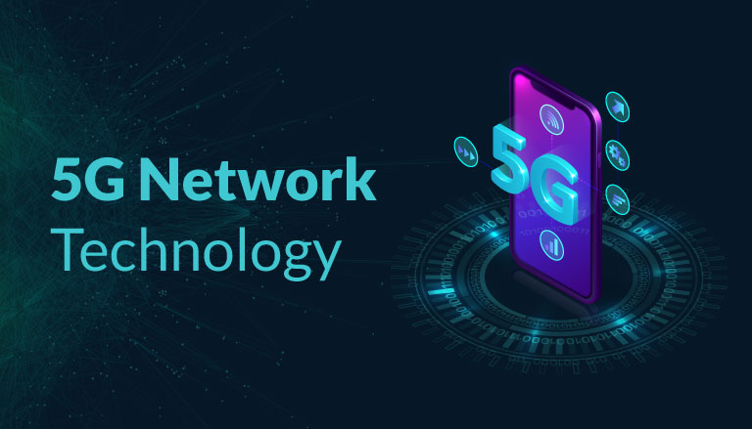
Advantages of 5G
Data BW of 1 Gbps or higher
Globally accessible
Dynamic information access
Available at low cost

Slide 10
Conclusion
3G- Operator Centric,
4G- Service Centric whereas
5G- User Centric
We have proposed 5G wireless concept designed as an open platform on different layers
The new coming 5G technology will be available in the market at affordable rates, high peak future & much reliability than preceding technologies

Slide 11
Any Questions ?

